Slide 1
Redefining: The Mind Shift at Microsoft on OSS & Community
Grace Francisco
August 2012

Slide 2
Who We Are
Grace Francisco
@gracefr
Mark Brown, @markjbrown
Brian Swan
@brian_swan
Michaela Kraft
@mickraft

Slide 3
Investing in standards
Embracing open source
Enabling open source on our platforms
Play well
with others
Listen to customers
Open in
the Cloud

Slide 4
Investing in Standards
more than 150 standards organizations
and more than 400 working groups

Slide 5
Microsoft+ Open Source
Our Motivation
Customers want platforms that work with other systems
End result
Enable customers to pick up a device, use a computing platform and simply know that it works the way they want.
Compatibility
Interoperability

Slide 6
Microsoft+ Open Source Momentum
app
downloads
Microsoft
Web
Gallery
>350,000
Op
open source apps run on Windows
23/25
23 of the top 25 most downloaded OSS projects run on Windows
28,000 Open Source projects
300,000+ registered users
>5M
Source: Geeknet

Slide 7
Microsoft+ Open Source
Microsoft Open Source Technology Center
Hyper-V Linux Integration Components
Device Driver Code for Linux
PHP Windows 5.3

Slide 8
Microsoft+ Open Source
Microsoft SQL Server
Open Source PHP library
Open Source ODBC library
Open Source JDBC library
ODBC

Slide 9
Microsoft+ Open Source
Microsoft Web Platform
WinCache
PHP Manager
jQuery
ASP.NET MVC
ASP.NET Web API
ASP.NET Razor View Engine
ASP.NET Entity Framework
ASP.NET

Slide 10
Microsoft+ Open Source
Windows Azure

Slide 11
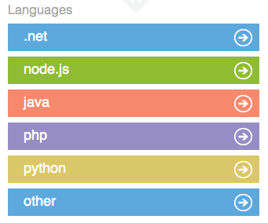
Microsoft+ OSS Documentation
MSDN
WindowsAzure.com
Channel 9
php.net
TechNet Wiki
Blogs
interoperability
brian_swan
silverlining
More Microsoft-produced OSS-related documentation than ever.
Examples:
PHP at Scale on the Microsoft Platform
Azure Real World: Migrating a Drupal Site from LAMP to Windows Azure

Slide 12
Examples of Openness with Drupal
2010
SQL Server/Azure integration
Zip files on drupal.org
2011
Drush on Windows
Drupal at Scale on Windows Training
2012
Drupal Supporting Partner, 7 DrupalCon events
WinCache and oData modules

Slide 13
Examples of Regional Openness at Microsoft
Local sponsorships
Drupal + Microsoft Health integration
Business Support
Drupal + SharePoint integration
OpenData + SharePoint integration

Slide 14
How we connect the dots

Slide 15
How we connect the dots

Slide 16
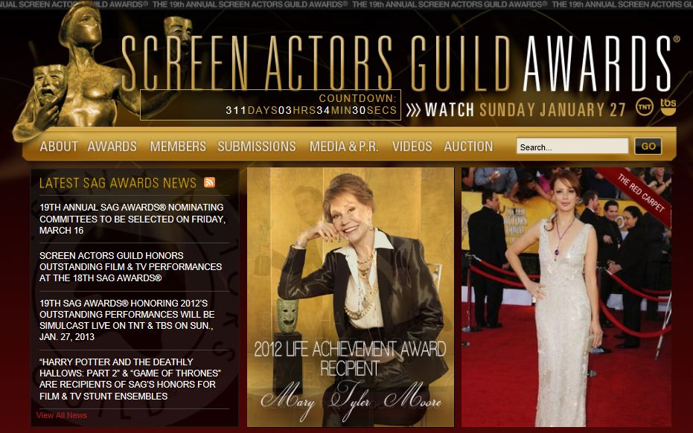
How we connect the dots
“We successfully moved our [Drupal] site to Windows Azure and the biggest traffic day for us went off with flying colors.“
Erin Griffin, CIO of Screen Actors Guild

Slide 17
Q&A

Slide 18
© 2012 Microsoft Corporation. All rights reserved. Microsoft, Windows, Windows Vista and other product names are or may be registered trademarks and/or trademarks in the U.S. and/or other countries.
The information herein is for informational purposes only and represents the current view of Microsoft Corporation as of the date of this presentation. Because Microsoft must respond to changing market conditions, it should not be interpreted to be a commitment on the part of Microsoft, and Microsoft cannot guarantee the accuracy of any information provided after the date of this presentation. MICROSOFT MAKES NO WARRANTIES, EXPRESS, IMPLIED OR STATUTORY, AS TO THE INFORMATION IN THIS PRESENTATION.

