Slide 1

23 August 2012
The Strategy Behind Designing for a CMS
Jozef Toth
Mogdesign.eu

Slide 2

The strategy behind designing for a CMS
Drupalcon Munich
Jozef Toth, Mogdesign.eu
mogdesign.eu
@jojototh
Notes:
Jozef Toth, CEO Mogdesign
frontend track chair - thank to speakers & attendees for making this awesome

Slide 3


@jojototh
Notes:
slovak based Drupal consulting company
@mog We build online communities for non profit organizations & businesses
very passionate about bringing great design to Drupal.

Slide 4

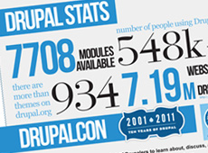

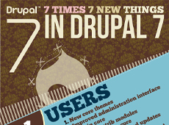

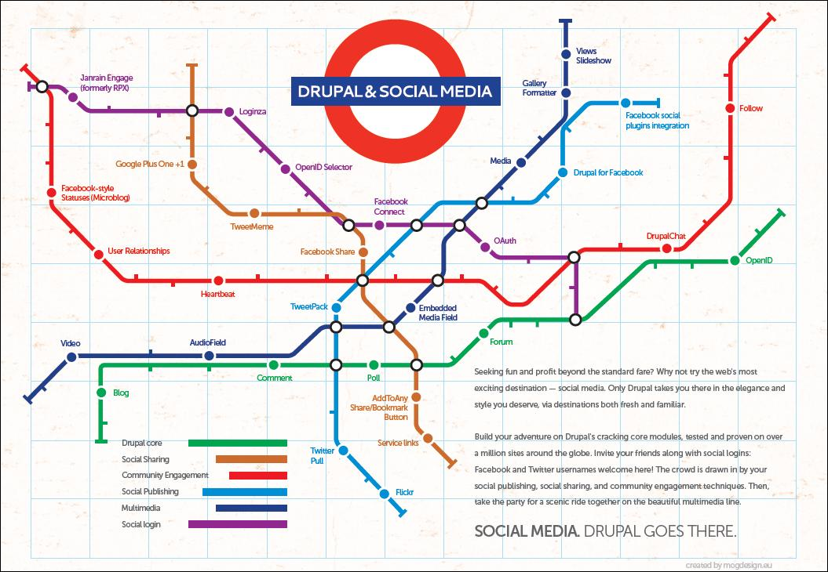

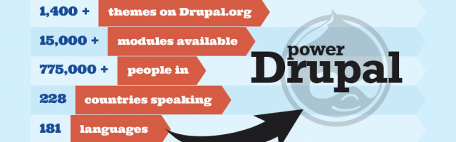
@jojototh
Notes:
Some of our work for Drupal community
branding for Drupal 7
marketing materials for the Drupal 7 launch & parties
Drupal infographics -take some

Slide 5
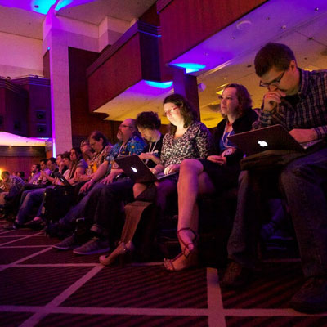
Who are you?
Designers
Themers
Developers
PM/Business guys
mogdesign.eu
@jojototh
Notes:
Who they are
Icebreaker: name 1-2-3

Slide 6
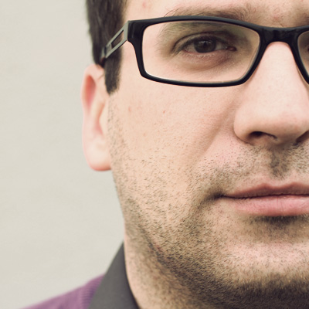
Who am I?
Geek
Designer
Themer
CEO
UX designer
mogdesign.eu
@jojototh
Notes:
around computers since teenager,
playing, hacking BIOS, Windows 95
guy that fixes computers for everyone
hobby, playing TTycoon AoEmpires discovered Photoshop - photo manipulations
enjoyed it, not sure if others

Slide 7
Who am I?
Geek
Designer
Themer
CEO
UX designer
mogdesign.eu
@jojototh
Notes:
ended up designing posters and flyers for events
my first real job printing company - asked to design and build a website for this company
learned some HTML/CSS and put together something in dreamweaver
2004 would like to be doing for living build static websites for friends, local companies
kept asking me for changes - must be way of building websites where they could manage themselves
found out about this CMS thing
trying Joomla, Modx or Typo 3, great tutorial for Drupal - changed my future:)

Slide 8
Who am I?
Geek
Designer
Themer
CEO
UX designer
mogdesign.eu
@jojototh
Notes:
started Drupal 4.5 - few years later working with US companies = designer & theme
first real project 3 nearly identical websites - 100 hours, 65, 30 hours
great teams, great developers, learned a lot, working on larg projects,
first Drupalcon, got to know the community
DC Washington, DC got together 1st time Drupal designers

Slide 9

Who am I?
Geek
Designer
Themer
CEO
UX designer
mogdesign.eu
@jojototh
Notes:
At that time kept hearing Drupal is ugly.
From experience I knew that it wasn't true, nothing wrong with Drupal itself,
can actually be used for beautiful websites,
So my reaction to it usually was: No, Drupal is not ugly, it is just that these other themers are lazy!

Slide 10
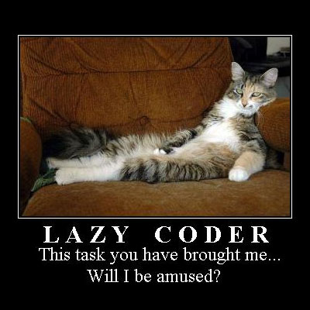
Who am I?
Geek
Designer
Themer
CEO
UX designer
mogdesign.eu
@jojototh

Slide 11
Who am I?
Geek
Designer
Themer
CEO
UX designer
mogdesign.eu
@jojototh
Notes:
In 2009 I've co-founded Mogdesign become a CEO.
My responsiblity shifted from visual design to
business development, user experience design sometimes also let me to manage a project
So I got another perspective to design & theming.
share a few lessons and ideas from 3 different perspectives
successful design, easier to theme, cost effective, still beautiful and meeting the client's needs
In other words - how to make everyone happy:)

Slide 12
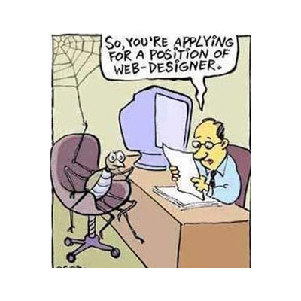
Designer
Print design vs web design
Successful design
Design for users
Beauty vs usability
mogdesign.eu
@jojototh

Slide 13
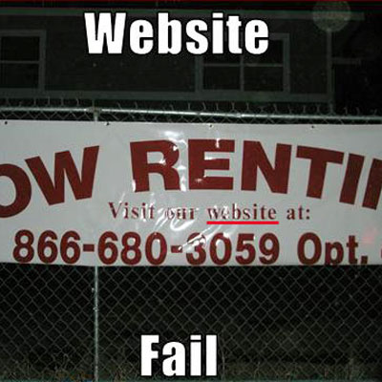
Print design vs web design
Differences
Canvas vs Screens
72 dpi vs 300 dpi
Font size – 10 vs 14
Colors - CMYK vs RGB
Image compression, size, format
mogdesign.eu
@jojototh
Notes:
Struggle to understand differences
Canvas:
- Dimensions of print format are same
- change for web with mobiles, tablets, responsive technologies
different output on every device types
Dpi, font, color, image

Slide 14
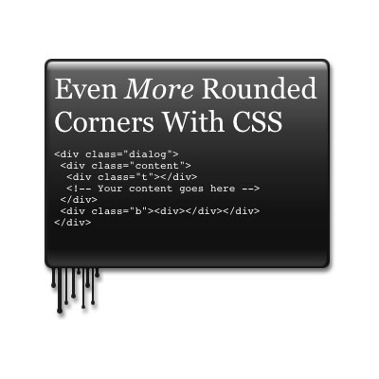
Print design vs web design
Problematic elements:
Shadows
Gradients
Rounded corners
Typography
Grids
Mark Boulton - http://bit.ly/grids-mb
Interactivity
mogdesign.eu
@jojototh
Notes:
Problematic elements:
- posters or flyers vs website
- with HTML 5 & new technologies more flexible
- but its important to learn about the limitations
Grids - Mark Boulton, session on DCs
Interactivity
- animations, forms, buttons, effects
- the key is to know when and how to use them
- Talk about it later

Slide 15
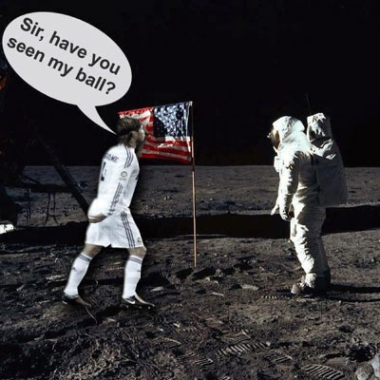
Successful design
Set goals and expectations
think before you design
focus on needs, not on the picture
Research
core of the business
what is the purpose
what is the message
target group
conversion/selling point
mogdesign.eu
@jojototh
Notes:
Points from slide
designer should be a marketer in a way, to sell the message/product

Slide 16
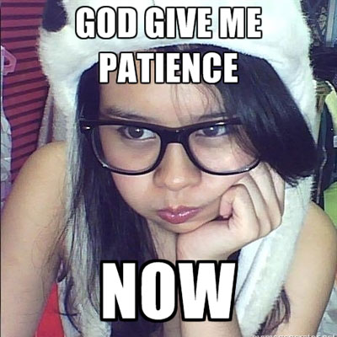
Design for users
don't like to think, act intuitively
are impatient
get distracted
hate visual noise
like conventional patterns
mogdesign.eu
@jojototh
Notes:
act intuituvely - scan the page & click on the first reasonable link
Impatient - if something does not work as they would like or it takes too long they leave
Distracted - you need to guide them & help them keep their focus
hate visual noise - digital claustrophoby, feel better with lots of whitespace
convencional patterns
- users want it as it is everywhere else, they like conventional patterns
- they expect same way of performing same tasks
- learn what it is, no need to reinvent the wheel

Slide 17
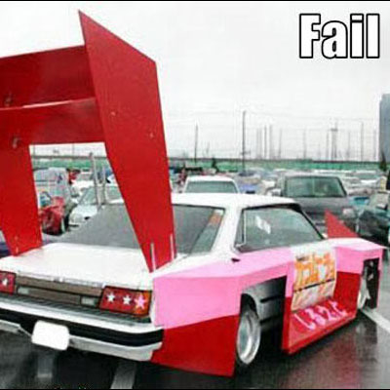
Beauty vs Usability
more effects ≠ awesomer design
The holy grail of web design
Content is the King
KISS - keep it simple stupid
mogdesign.eu
@jojototh
Notes:
more awesome effects and hot stuff = more awesome it will be
Truth is that many times it is exactly the opposite
holy grail of webdesign
design as a supporting element
helps user to focus on most important - information, content
find the shortest way to information or conversion point
and use design to support that journey
not saying that you shouldn't be following the latest trends, or try hot new stuff
find a way of using that for support the user experience.
Don't forget - 99% of visitors not desingers
will not have any benefit from seeing latest trends
They simply want to find the information which brought them to your website
Learn about usability, creating user experience
think as a visitor and not as a designer

Slide 18
Designer
Print design vs web design
Successful design
Design for users
Beauty vs usability
mogdesign.eu
@jojototh

Slide 19
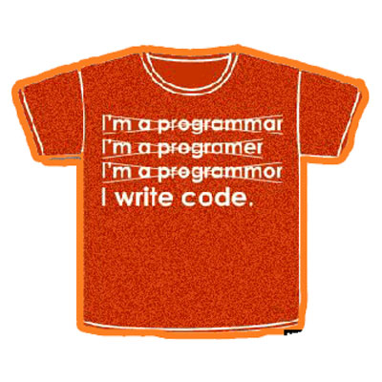
Themer
To theme or not to theme?
Consistency
Clean up your PSD
mogdesign.eu
@jojototh

Slide 20

To theme or not to theme?
15-25% vs 75% of project
Learn about Drupal
Learn about the hot new stuff
Talk to developers
Get feedback
mogdesign.eu
@jojototh
Notes:
ongoing discussions if designer should be coder/themer
from my experience it really helps.
absolutely necessary to understand 15%-25%
in order to be sucessful you must understand what the 75% is
Drupal - build a site for yourself to understand what are its elements, theme, blocks, regions, etc...
hot new stuff - technologies and buzzwords mobile, responsive, jquery ui
Talk to developers - learn how they use them to deliver the project
Get feedback - from developers on design, if it is doable, if you should change it
according to Steve Krug, testing one user is 100% better than testing none
This will help you to put elements in the place where they naturaly belong in Drupal
which can make theming easier in some cases

Slide 21
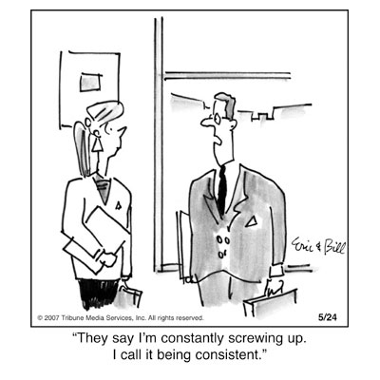
Consistency
use same layout/style
design in a generic way
content navigation
grid system
image sizes
mogdesign.eu
@jojototh
Notes:
most common issues with design
block on homepage & on a subpage has completely different look
block title has a different font or margin/border
layout/style - for views, blocks, headlines, font sizes, line heights, borders, margins, comments, images accross the whole website.
generic - dont put same block in different sidebars
keep things simple, dont unnecesary overcomplicate the design
content navigation - how you get from one page to other - homepage > listing > detail
- dont miss read more links, breadcrumbs
Grid system in design, use standardized layout (I use 960 - 12 columns)
image sizes - different thumbnail sizes

Slide 22

Clean up your PSD
layers
groups
versions
mogdesign.eu
@jojototh
Notes:
name the layers, give each layer an easy to identify name
- arrange them in order as they appear in design
- group layers in logical units - go from top to bottom - from body to page to regions to block to content pieces etc
- CS5/6 vs users with older version can end up with broken PSD file - nested groups

Slide 23
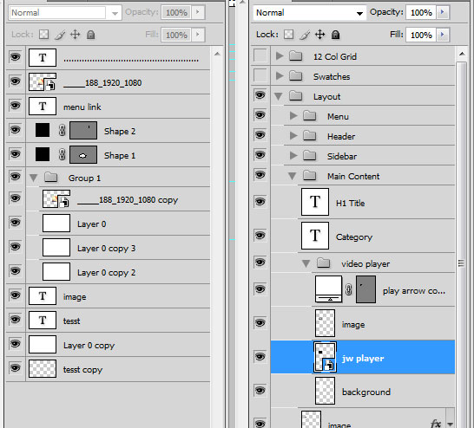
mogdesign.eu
@jojototh
Notes:
name the layers, give each layer an easy to identify name
- arrange them in order as they appear in design
- group layers in logical units - go from top to bottom - from body to page to regions to block to content pieces etc
- CS5/6 vs users with older version can end up with broken PSD file - nested groups

Slide 24
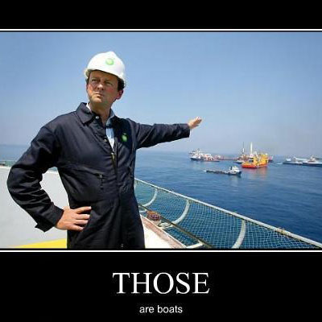
CEO
Cost effectivenes
Delivering on time
mogdesign.eu
@jojototh

Slide 25
Themer
To theme or not to theme?
Consistency
Clean up your PSD
mogdesign.eu
@jojototh

Slide 26

Cost effectivenes
all of the above
style guide / design manual
update the design manual
post it notes
design what is necessary
use real life content
required vs optional content
mogdesign.eu
@jojototh
Notes:
15% - 25% of total time - but what is important is how the design will affect the hrs needed to theme and develop
2 designs can cost same money but the development can be 2x more expensive
What are the factors that affect the cost of design/theme?
- All of the above
style guide: a specific page with all often used HTML & Drupal elements and image sizes, typography
update the design manual with changed elements
post it notes with descriptions
design only what is necessary
use real life content to make sure that it will fit where you designed it
- know which content is required, and which is optional. It will look different if the optional content is not filled

Slide 27
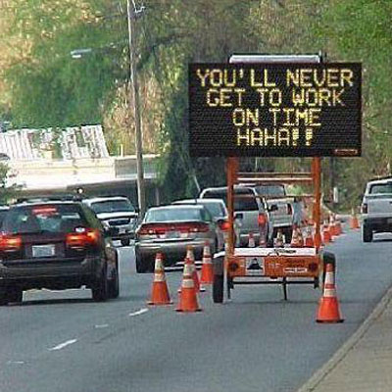
Delivery on time
define terminology upfront
QA with client & PM
set rules for feedback
finish the project
mogdesign.eu
@jojototh
Notes:
terminology upfront (labels, buttons, taxonomy terms, content types)
if it changes it creates a lot of overhead
QA the design with developers, PM & client
set rules for rounds of feedback and changes
finish the project, don't leave it open ended

Slide 28
Resources
Drupal elements & style guide
Mogdesign.eu - http://bit.ly/OWxjLD
Zivtech - http://bit.ly/OWxsif
Chapter 3 - http://bit.ly/OWxx5s
Reload.dk - http://bit.ly/OWxAhA
Modules
http://drupal.org/project/styleguide
http://drupal.org/project/styleguide_extras
Videos
LA Drupal - http://bit.ly/OWxGpB
mogdesign.eu
@jojototh

Slide 29
Thank you!
@ jojototh
jozef@mogdesign.eu
http://munich2012.drupal.org/program/sessions/strategy-behind-designing-cms
mogdesign.eu
@jojototh

